Slide 1
Telling Your Story
June 23, 2015
Carl Graziano, Director of Communications
Sandy Laycox, MFA, Senior Writer and Editor

Slide 2
Three Main Messages
SAVINGS – 340B creates savings for everyone.

Slide 3
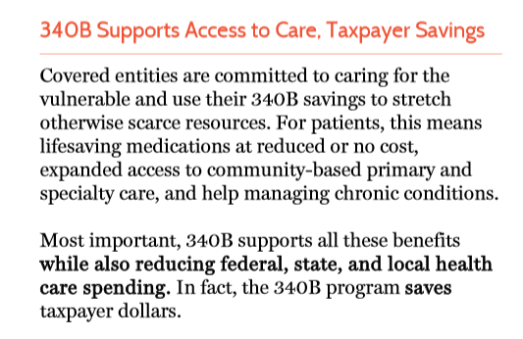
SAVINGS in Bold

Slide 4
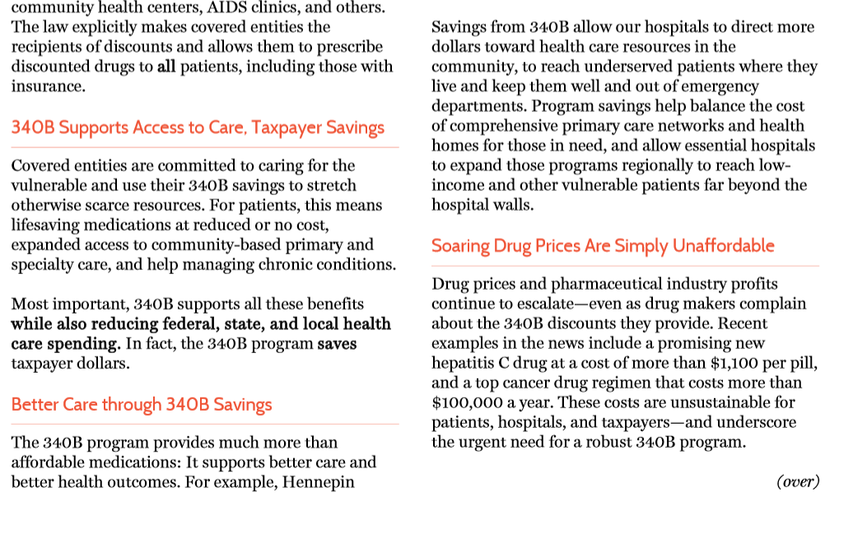
Savings Everywhere

Slide 5
SAVINGS Through Patient Story
Hennepin County Medical Center Patient Story
USE #1 – 340B savings led to better care management, better patient health, and thus – even more savings in patient care.

Slide 6
Three main messages
SAVINGS – 340B creates savings for everyone.
CONSTITUENTS – 340B matters to voters.

Slide 7
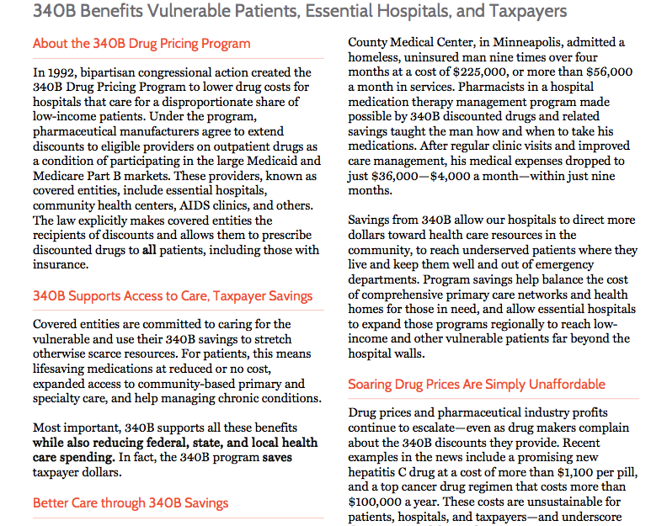
Taxpayers THroughout

Slide 8
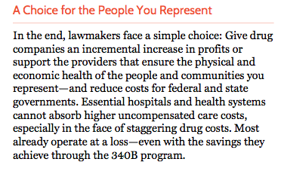
The people you represent

Slide 9
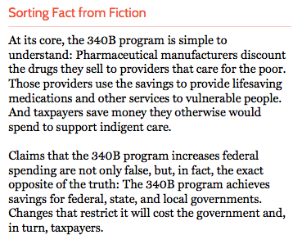
Taxpayers save or Taxpayers Pay

Slide 10
Three main messages
SAVINGS – 340B creates savings for everyone.
CONSTITUENTS – 340B matters to voters.
PHARMA – It’s us versus them on 340B.

Slide 11
Data highlight pharma profits
High Cost of Drug Regimen Data
USE #1 – Pushing back on the pharmaceutical industry, highlighting profits

Slide 12
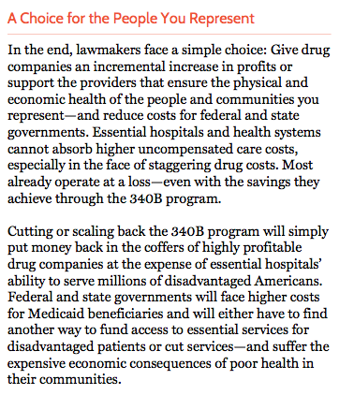
Profits Vs. Savings

Slide 13
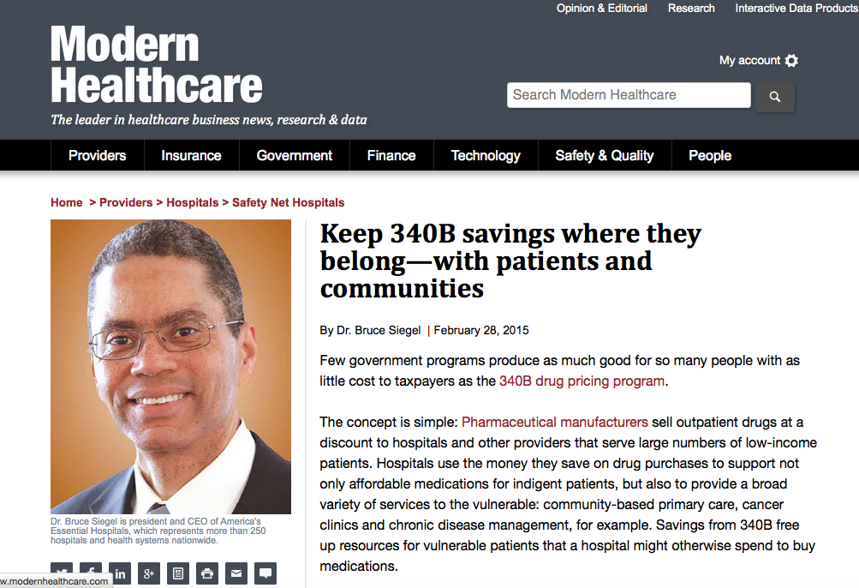
Public-Facing Messaging

Slide 14
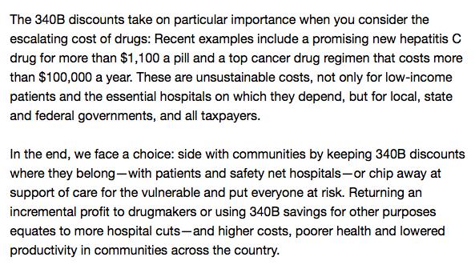
In Closing

Slide 15
Data highlight cost of drugs without 340B
High Cost of Drug Regimen Data
USE #1 – Pushing back on the pharmaceutical industry, highlighting profits
USE #2 – Showing how costly drugs would be for all of us without 340B

Slide 16
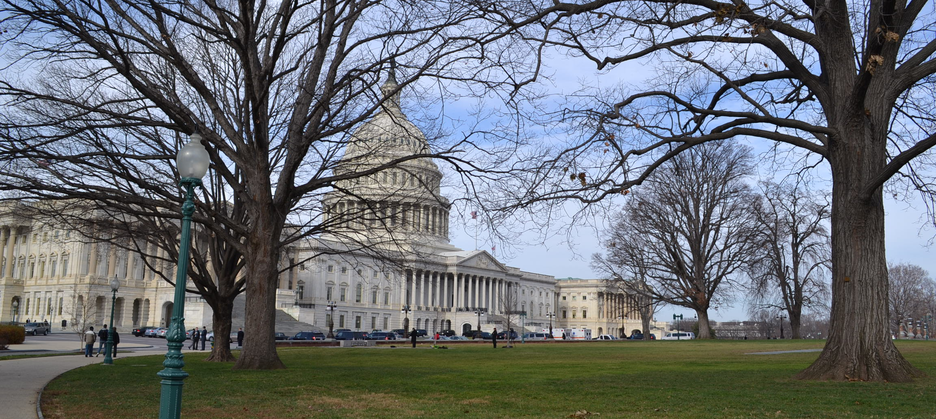
340B TESTIMONY

Slide 17
A law-abiding program
America’s Essential Hospitals and our members support integrity and transparency in federal health care programs. We welcome efforts to ensure the 340B program operates as Congress intended…
At its most basic level, the 340B program requires pharmaceutical manufacturers to provide outpatient drugs at a discount to hospitals and other providers that care for a disproportionate share of low-income and other vulnerable patients. Hospitals use their 340B savings in many ways, as the law plainly allows…

Slide 18
NOT a financial burden
The ability of the 340B program to accomplish so much for so little public investment makes it imperative we protect this program….
The story is the same across the nation: affordable drugs to help patients avoid more costly conditions and treatments—and all possible for only a nominal administrative cost and no direct federal funding.

Slide 19
Patient story shows 340b works
Hennepin County Medical Center Patient Story
USE #1 – 340B savings led to better care management, better patient health, and thus – huge savings in patient care
USE #2 – 340B works as it was intended, lower costs and better health outcomes

Slide 20
Data say Protect 340B
High Cost of Drug Regimen Data
USE #1 – Pushing back on the pharmaceutical industry, highlighting profits
USE #2 – Showing how costly drugs would be for all of us without 340B
USE #3 – Unaffordable drugs indicate need to protect 340B

Slide 21
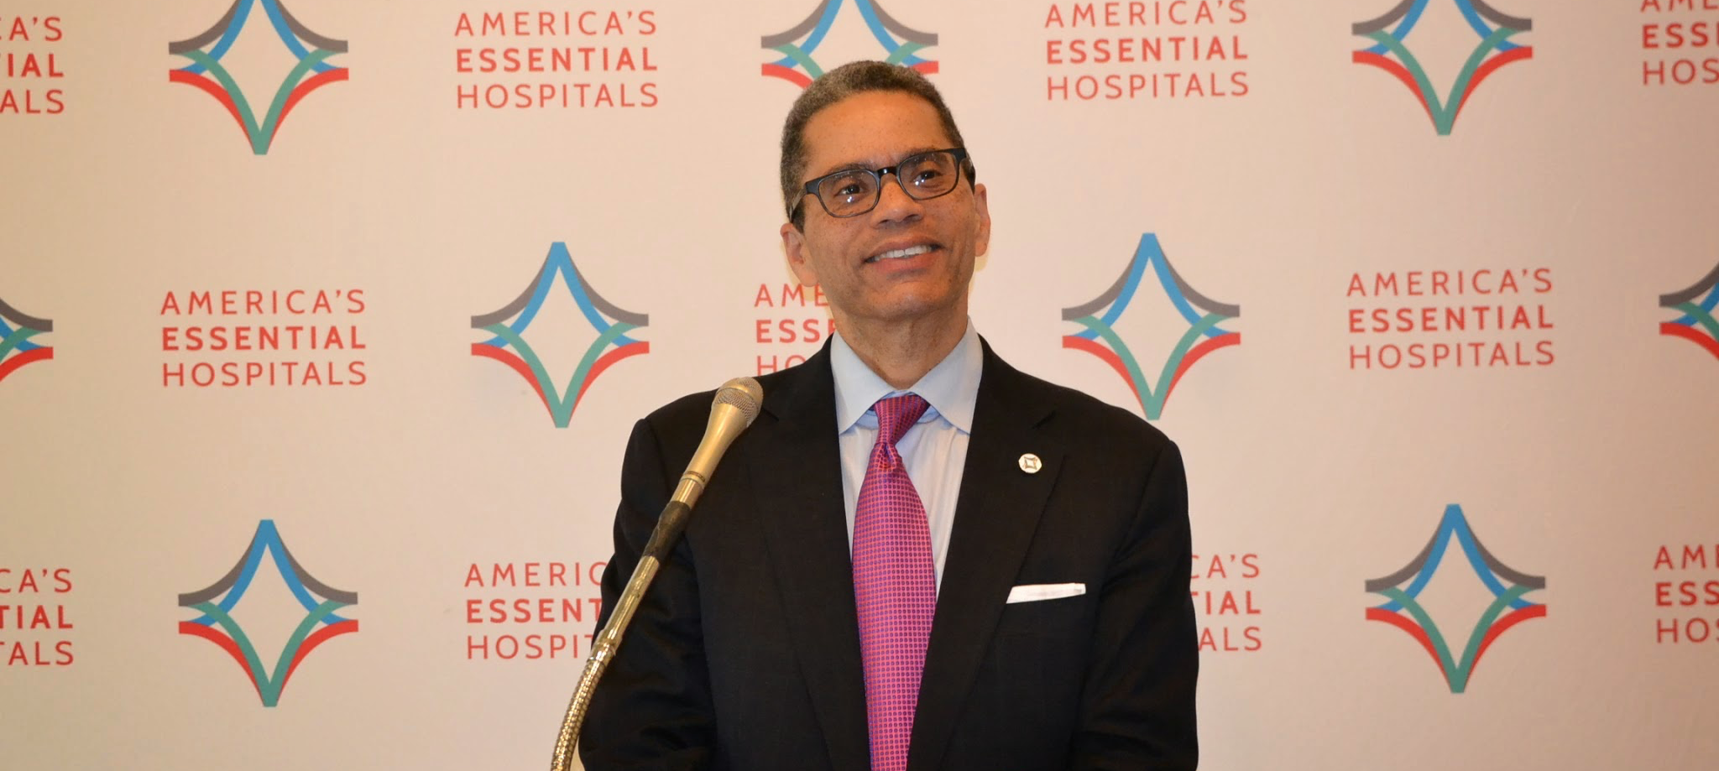
340b motivation, inspiration

Slide 22
Patient story is effective advocacy
Hennepin County Medical Center Patient Story
USE #1 – 340B savings led to better care management, better patient health, and thus – huge savings in patient care.
USE #2 – 340B works as it was intended, lower costs and better health outcomes
USE #3 – Encouraging storytelling during Hill visits, example of its effectiveness

Slide 23

340B as part of a larger picture

Slide 24
Patient story re-imagined
Hennepin County Medical Center Patient Story
USE #1 – 340B savings led to better care management, better patient health, and thus – huge savings in patient care.
USE #2 – 340B works as it was intended, lower costs and better health outcomes
USE #3 – Encouraging storytelling during Hill visits, example of its effectiveness
USE #4 - ???

Slide 25
Words resonate
USE THIS…. | …NOT THAT (most of the time)
340B Drug Pricing Program | 340B Drug Discount Program
340B savings | 340B funding (or revenue)
Affordable Care Act | Obamacare
essential hospitals | safety net hospitals
funding support | financing
vulnerable people | poor patients
operating margin | profit
sustainable funding | higher payments
(Medicaid is a) lifeline | safety net
teaching mission | physician training
Notes:
Note on “teaching mission” – using it to reflect the fact that our members go above their GME caps, consistent with how they go above and beyond in other mission-driven work.

Slide 26
MAKING YOUR CASE WITH DATA
Notes:
At this point, I[‘m going to turn the presentation over to Katie Reid, our data and analytics expert here on staff
She’ll talk about data available to you, as members, to help support the essential hospital model and other messaging
And she and I both will talk about some of the custom data sources available to you.
Katie?

Slide 27

Data: Use it Sparingly
1 - 3 most compelling data points
Resist the urge to data dump
Use terms they understand
Complement key messages
Make it visually interesting

Slide 28
DATA: Consider your audience
“DSH cuts could mean the loss of 300 jobs and $42 million in economic activity.”
“DSH cuts could mean the closure of eight clinics in the city’s poorest neighborhoods.”

Slide 29
Essential hospitals, vital data

Slide 30
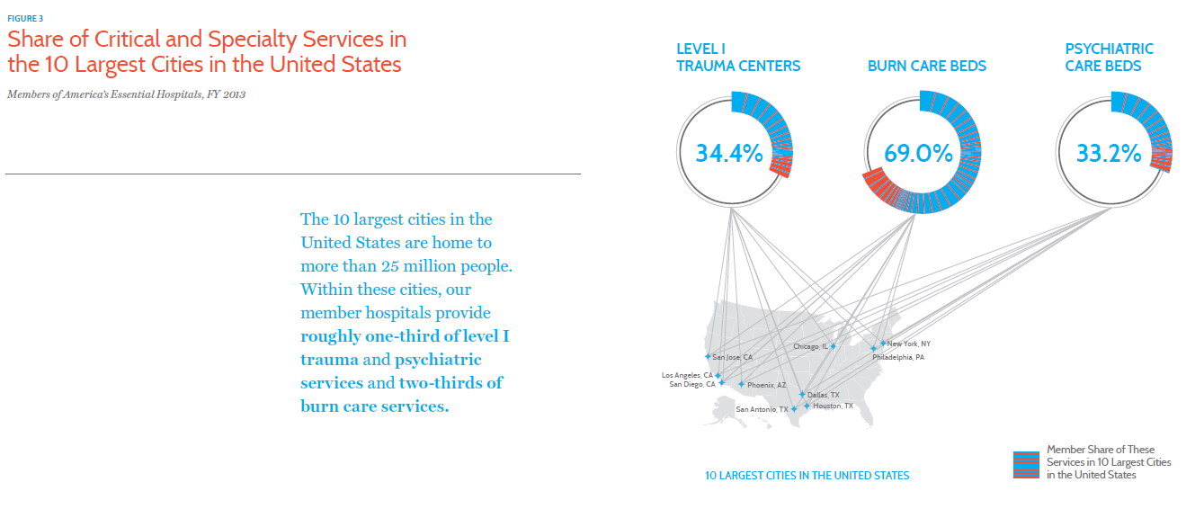
Critical services

Slide 31
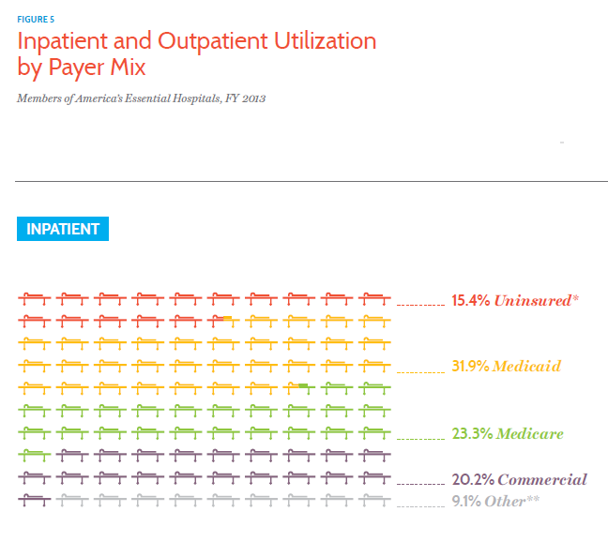
Patient demographics

Slide 32
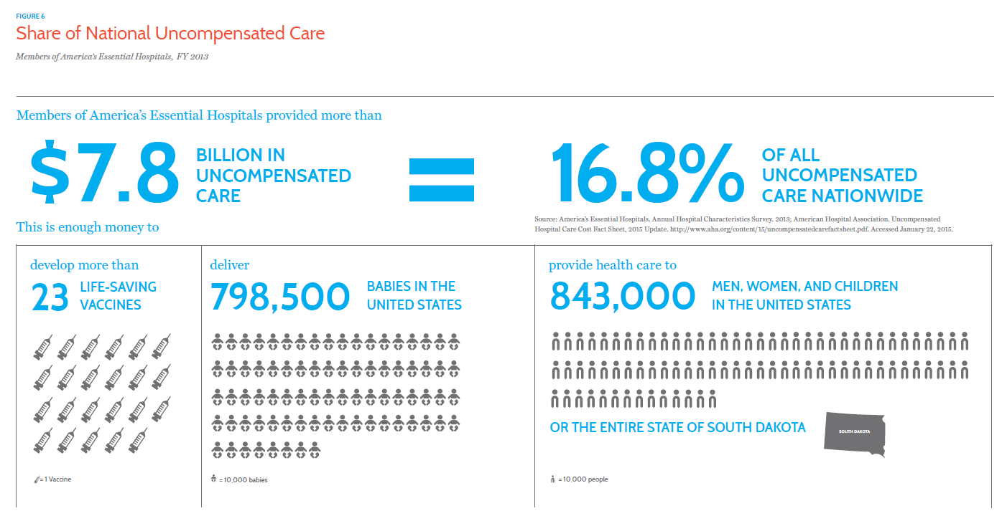
Uncompensated care

Slide 33
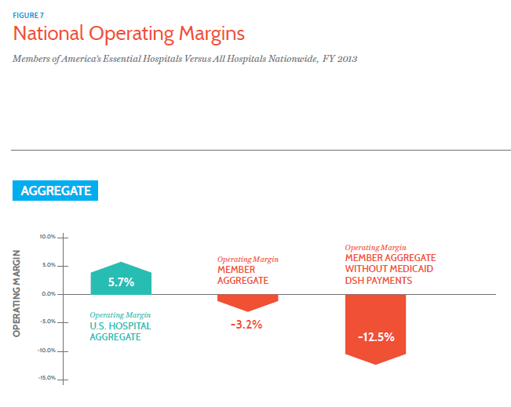
Hospital finances

Slide 34
Requesting custom data
Additional data points available from association:
Summary statistics
Peer group analyses
Quality benchmarking
Other data sources include:
AHA Annual Survey of Hospitals
Hospital Compare quality data
Healthcare Cost and Utilization Project (HCUP) data
CMS Cost Reports
CDC data sources – BRFSS, NHANES, NHSN
National Trauma Data Bank
Notes:
HCUP: The Nation’s most comprehensive source of hospital data, including information on in-patient care, ambulatory care, and emergency department visits. HCUP enables researchers, insurers, policymakers and others to study health care delivery and patient outcomes over time, and at the national, regional, State, and community levels.
BRFSS: The Behavioral Risk Factor Surveillance System is the nation's premier system of health-related telephone surveys that collect state data about U.S. residents regarding their health-related risk behaviors, chronic health conditions, and use of preventive services. Established in 1984 with 15 states, BRFSS now collects data in all 50 states as well as the District of Columbia and three U.S. territories. BRFSS completes more than 400,000 adult interviews each year, making it the largest continuously conducted health survey system in the world.
NHANES: The National Health and Nutrition Examination Survey is a program of studies designed to assess the health and nutritional status of adults and children in the United States. The survey is unique in that it combines interviews and physical examinations.
NHSN: CDC’s National Healthcare Safety Network is the nation’s most widely used healthcare-associated infection tracking system.
NTDB (American College of Surgeons): The largest aggregation of trauma registry data ever assembled.

Slide 35
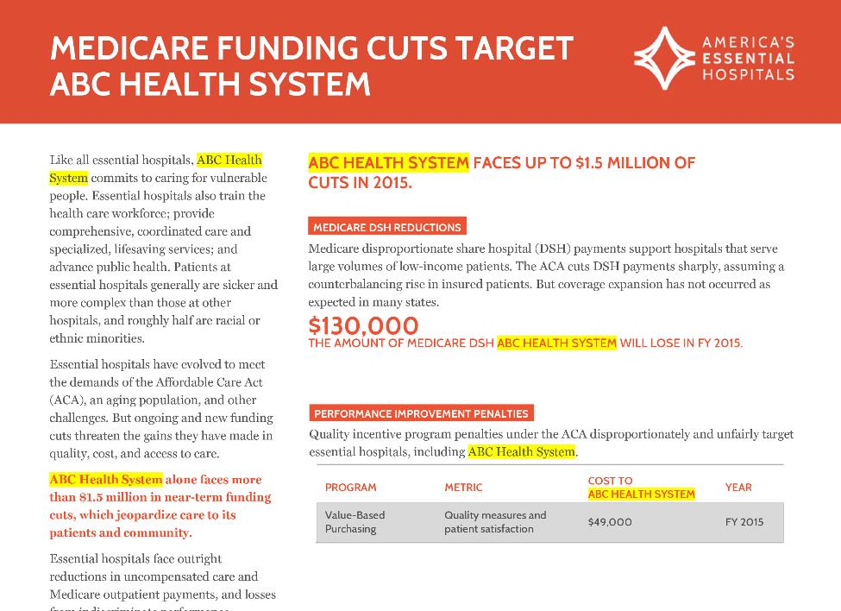
More custom data resources
Notes:
In addition to the those great data sources from our research team, we also can offer to you hospital-level data on funding and other policy issues
On this slide, is a sample of a policy one-pager we can provide that lays out the many current and potential Medicare funding cuts to your hospital.
Where you see yellow highlight are some of the paces throughout this piece that would incorporate your hospital name, and the various data points would be based on our analysis for your institution.
This grew out of a larger, aggregate policy brief on Medicare cuts. We realized the value this would have as an advocacy tool for individual members.

Slide 36
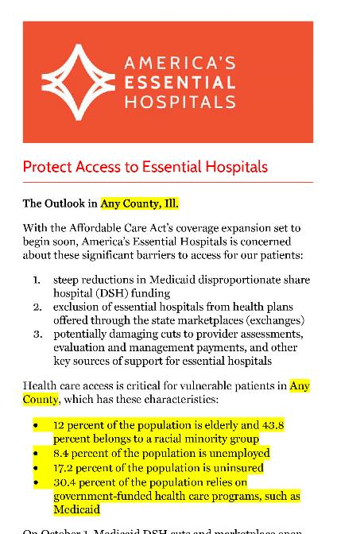
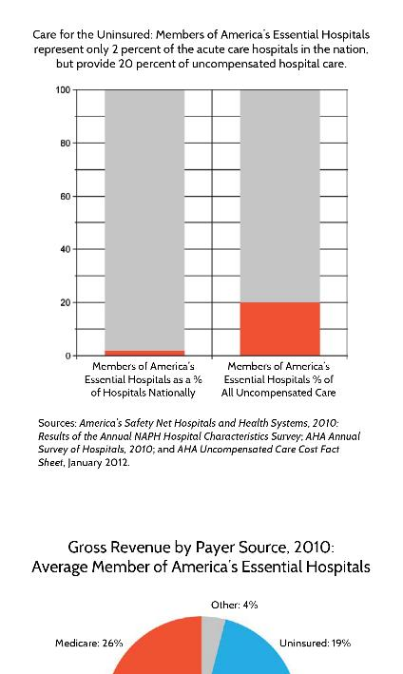
More custom data resources
Notes:
Similarly, we can provide this for you. It’s a pocket card we produce a couple times a year for our legislative fly-in here, in Washington.
But, this is something we can provide to you any time of the year
It has demographic data specific to your county or serviced area, including the size of your minority population, percentages of unemployed and underinsured, the percentage of people who rely on government-funded health care programs.
These are value points to have in your back pocket when you’re going up to Capitol Hill or into your state houses to make the case for continued hospital funding.

Slide 37
SPEAKING WITH ONE VOICE
Notes:
I want to wrap up by talking a little about how we can support your messaging and media relations work directly – and help us all speak with one voice.

Slide 38
Talking points
The uninsured and uncompensated care
340B Drug Pricing Program
Sociodemographic risk adjustment
Hospital ratings and pay for performance
CEO salaries
The charge master and service pricing
Notes:
First, I want you to be aware that we can help you directly shape your messages with various resources.
We regularly develop talking points on various topics and issues – this slide lists just some of the ones we’ve written in recent years.
We approach all our talking points with many of those themes and messaging approaches I talked about earlier – and, of course, our essential hospitals model.
So, for example, you’ll see in our 340B talking points, a lot of language about how 340B savings help a hospital meet its other commitments to the community and that the community at large would be at risk if those savings fall away.
We’re constantly tying back our messaging to those overarching themes and the one-plus-four model.
We can be fairly nimble about talking points and turn around content quickly for you if you need it.
We did that just last week, when Medicare released its Hospital Compare star ratings on patient satisfaction. We already had a pretty well developed set of talking points in place for how our patient mix affects measures of satisfaction. So, it didn’t take much work to tailor those to this latest development.
We did get requests for messaging from a couple of our members, and were able to get those out quickly.
That was a perfect example of how you can use us as a resource as these policy issues crop up at the local level.

Slide 39
Media support
“There’s a mission and a sense of reward that is really unique to these institutions,” Siegel said of public hospitals. “Brian Brannman was very well received. He was seen making a difference there. I think that bodes very well for them.”
—Las Vegas Sun
But to the Health and Hospitals Corporation, the city’s public hospital agency, it is not merely another insurance plan. The corporation created MetroPlus ... The Henry Ford Health System in Detroit, which has roots in organized labor and the auto industry, has signed up about 4,000 people in its exchange plans ... The University of Arizona Health Plans have attracted ...
—The New York Times
We are definitely seeing an impact, but it's a small number compared to the overall population, said Mark Newton, the chief executive of Swedish Covenant Hospital in Chicago.
—The Wall Street Journal
Notes:
Another benefit available to you is media support – and we do a lot of this with our members and it really works toward creating a unified voice for essential hospitals.
We’re happy to arrange comment from Bruce Siegel, our CEO, or someone else in leadership if you need support locally – and we’ve had members point reporters our way many times over the past few years.
The first call-out on this slide is from a story last year in the Las Vegas Sun on the search for a new CEO at University Medical Center of Southern Nevada. This is just one part of extensive comment from Bruce on the differences between public and nonprofits and for-profit hospitals in attracting and retaining C-suite leadership. It provided important context to the ongoing debate there about executive leadership for that hospital.
Also, frequently arrange for our members to have a voice in national stories by serving as on-the-ground sources.
The other two call-outs on this slide are examples all from the past year
The first is an excerpt from The New York Times. This was a story about public hospitals participating in ACA insurance exchanges with qualified health plans of their own. It really helped, I think, position our members as innovators and goes to that lean-forward stance I mentioned earlier as a goal of our messaging.
The last example is from a WSJ story about the roll-out of ACA coverage and what hospitals are seeing on the front lines, and included comment from one of our Chicago hospitals, Swedish Covenant. This grew from a larger effort to show how our hospitals contributed to ACA enrollment efforts and this and other stories we collected were particularly well received by the White House.
That’s an important point – that when we recruit you as local sources, it almost always supports a broader communications goal that benefits all essential hospitals.

Slide 40
Other resources
Social media (@OurHospitals)
essentialhospitals.org
Essential Insights blog
Walls Down (wallsdownmag.org)
Member stories
Notes:
Other resources to help amplify our collective voice are listed here:
We have a very active Twitter feed and follow all our hospitals that are active on Twitter. If you don’t follow us, I encourage you to do so – retweeting each other is a great way to expand our reach on various messaging campaigns.
Our website, essentialhospitals.org, has a strong storytelling element and numerous opportunities for us to work with you to talk about and promote your successes.
We have blog and invite you to contribute
Walls Down, our new online magazine, is our long-form storytelling platform – magazine quality articles and sidebars built around a theme. Our first issue focused on various specialized services (stroke care, disaster response, NICU) – another example of carrying the essential hospitals message and our one plus four model.
And finally, we used member stories and case studies across many communications – especially in advocacy, where they be powerful examples of how our members put to good use the resources we lobby for, here in Washington.
So, I strongly encourage you to share your stories with us, even if it’s not for a specific public use, such as on our website.

Slide 41
THANK YOU
Notes:
I want to wrap up by talking a little about how we can support your messaging and media relations work directly – and help us all speak with one voice.

